Slide 1
Network Analysis

Slide 2
Outline
Graphs & Networks
Graph Properties
Advanced Topics
Communities
Influence/Spreading
Graph Analysis Tools

Slide 3
Graphs & Networks
Graphs have been studied by lots of people for a long time
Networks are typically represented as graphs
Networks are the underlying structure of many natural phenomena

Slide 4
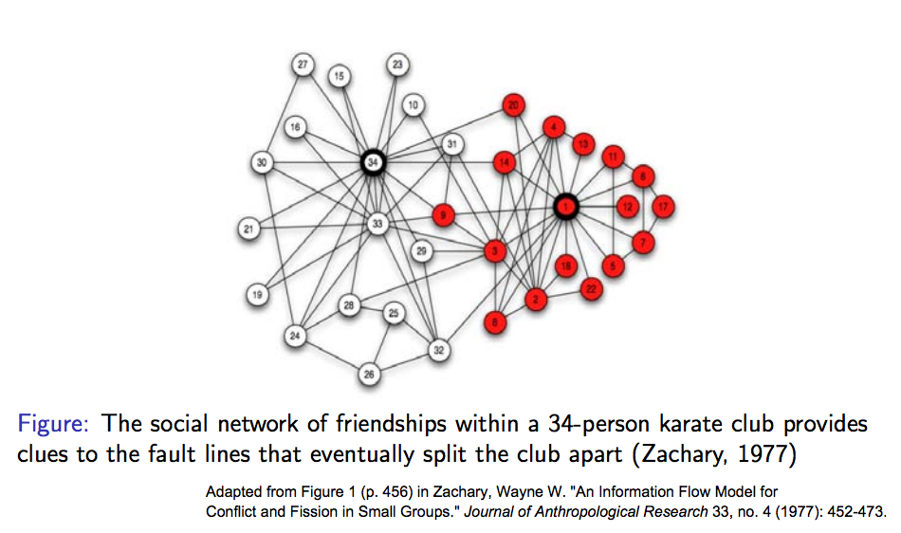
Karate Club

Slide 5
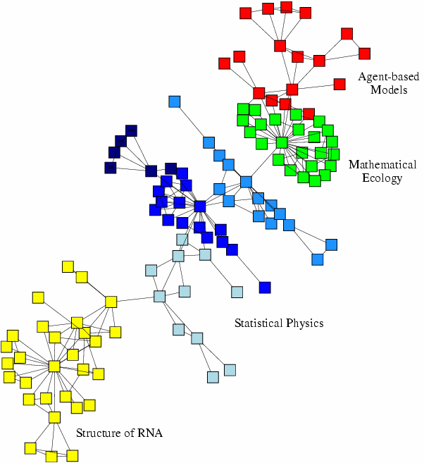
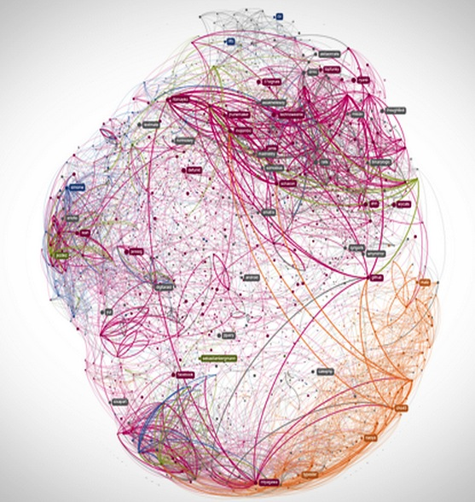
Collaboration Networks
Github collaboration 600k nodes

Slide 6
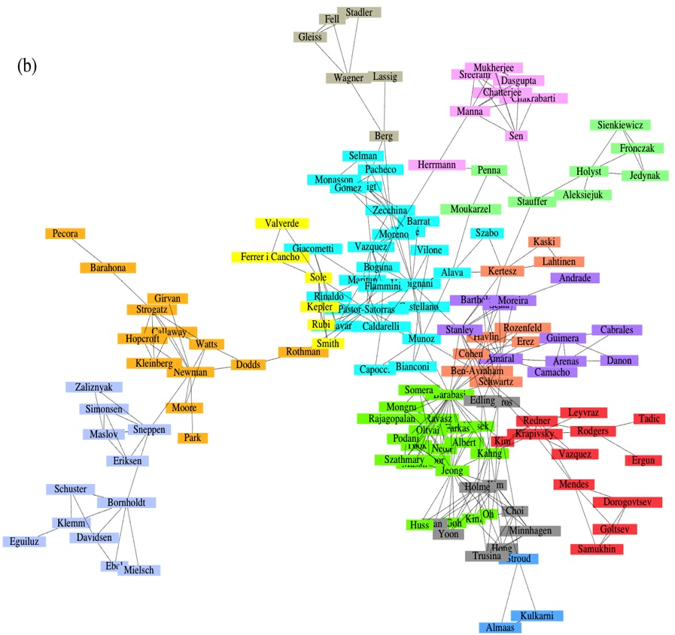
Collaboration Networks
Collaboration Network:
Nodes: Scientists
Links: Joint publications
Physical Review:
1893 – 2009.
N=449,673
L=4,707,958.

Slide 7
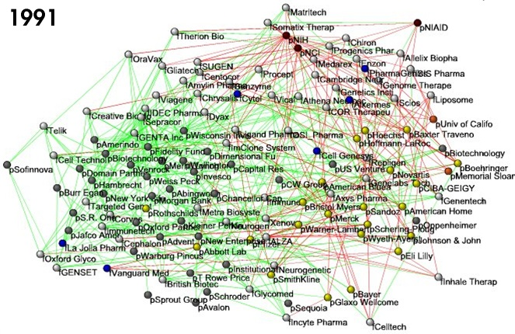
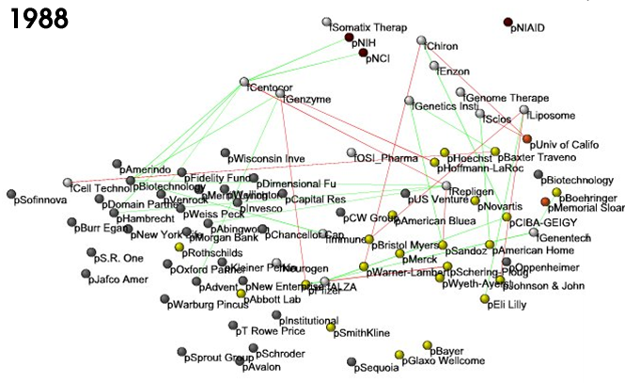
Nodes:
Companies
Investment
Pharma
Research Labs
Public
Biotechnology
Links:
Collaborations
Financial
R&D
http://ecclectic.ss.uci.edu/~drwhite/Movie

Slide 8
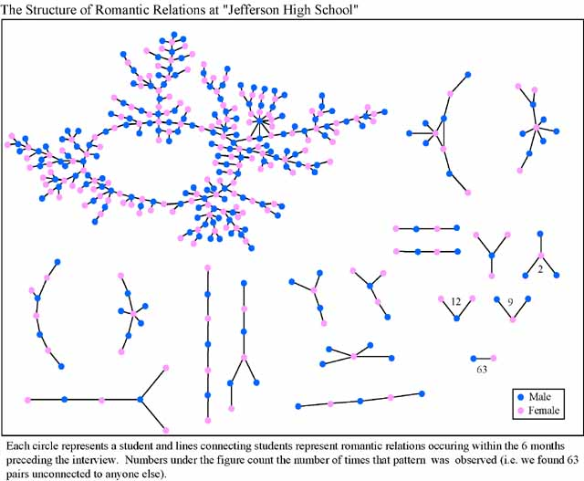
Dating Network

Slide 9
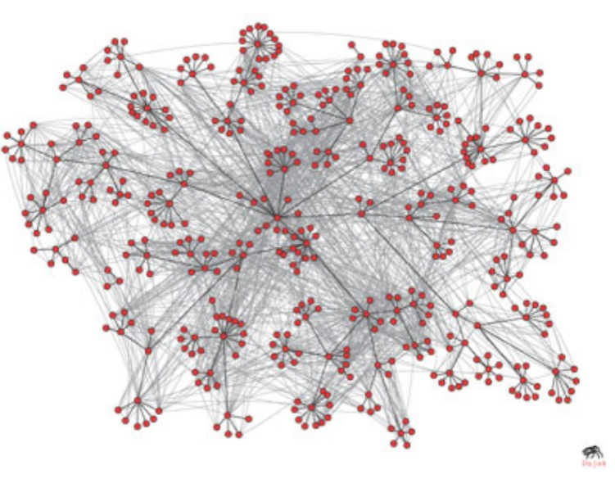
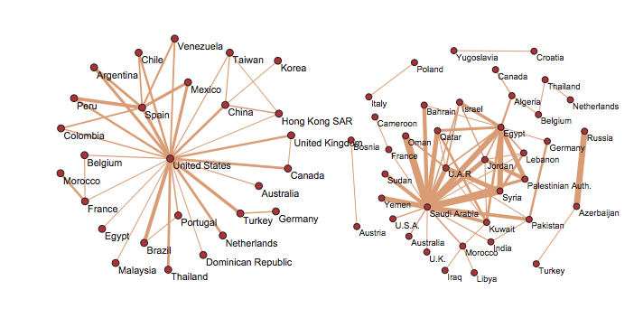
Communication Networks

Slide 10

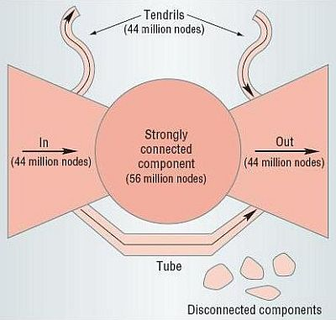
Information Linking Networks

Slide 11
Networks (graphs)

Slide 12
Types of graphs/networks
Directed/undirected
Multi graphs (multiple edges between nodes)
Hyper graphs (edges connecting multiple nodes)
Bipartite graphs (e.g., papers to authors)
Weighted networks
Different type nodes and edges
Evolving networks:
Nodes and edges only added
Nodes, edges added and removed

Slide 13
Graph Vocabulary
Nodes
Edges
Paths: sequence of nodes with each consecutive pair in the sequence is connected by an edge
Cycles: > 2 edges, in which the ﬁrst and last nodes are the same, but otherwise all nodes are distinct.
Directed or undirected
Adjacency matrix
Distance: length of the shortest path between 2 nodes
Weighted/unweighted
Connected: If, for every pair of nodes, there is a path between them
Connectivity:
Components
Giant Components
Bipartite
Graph Theory
“Terminological jungle, in which any newcomer may plant a tree” (John Barnes)
Notes:
Erdos number http://academic.research.microsoft.com/

Slide 14
Connectivity
A Connected Component is a subset of the nodes such that:
every node in the subset has a path to every other; and
the subset is not part of some larger set with the property that every node can reach every other.
B
B
A
Largest Component:
Giant Component
A
F
C
D
F
C
D
F
The rest: Isolates
F
G
G
Bridge: if we erase it, the graph becomes disconnected.

Slide 15
Connectivity
Strongly connected directed graph: has a path from each node to every other node and vice versa (e.g. AB path and BA path).
Weakly connected directed graph: it is connected if we disregard the edge directions.
B
E
A
B
F
A
D
E
C
D
C
G
F
G
In-component: nodes that can reach the scc,
Out-component: nodes that can be reached from the scc.
Network Science: Graph Theory 2012

Slide 16
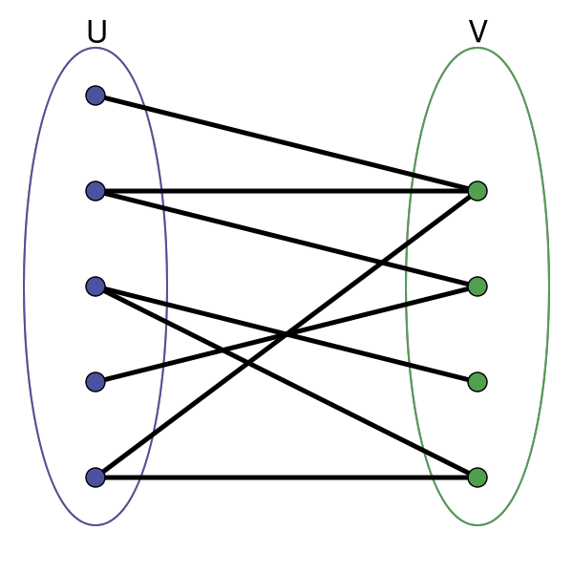
Bipartite Graphs
Nodes can be divided into two disjoint sets U and V such that every link connects a node in U to one in V; that is, U and V are independent sets.
Examples:
Collaboration networks
Disease network (diseasome)

Slide 17
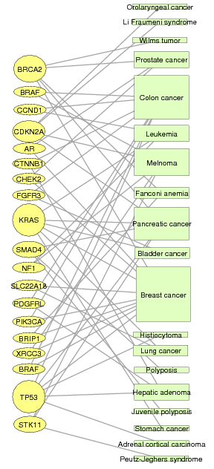
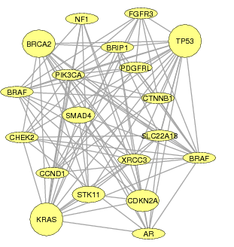
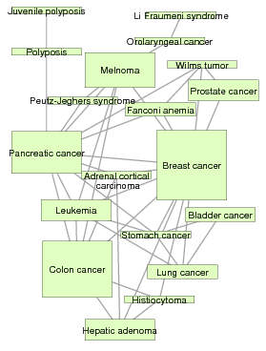
Disease Network
DISEASOME
PHENOME
GENOME
Gene network
Disease network
Goh, Cusick, Valle, Childs, Vidal & Barabási, PNAS (2007)
Notes:
Erdos number http://academic.research.microsoft.com/

Slide 18
Representation: How to turn something into a graph?
How you turn relationships into a graph defines what you can study, analyze, and infer.
This is often the most important decision to make

Slide 19
Study of Networks
Sociologists were first to study networks:
Study of patterns of connections between people to understand society
Typical questions: Centrality and connectivity
Limited to small graphs (~10 nodes) and properties of individual nodes and edges
Large networks (e.g., web, internet, on-line social networks) with millions of nodes
Many traditional questions not useful anymore:
Traditional: What happens if a node U is removed?
Now: What percentage of nodes needs to be removed to affect network connectivity?
Focus moves from a single node to study of statistical properties of the network as a whole
Can not draw (plot) the network and examine it

Slide 20
Study of Networks
What does the network “looks like” even if I can’t look at it?
Statistical methods and tools to quantify large networks

Slide 21
Network Measures
Degree measures
In-degree
Out-degree
Average
Distribution
Diameter: maximum (shortest) distance between any pair of nodes in the graph
Average Path length: Avg # steps along the shortest paths of all possible pairs of nodes (efficiency)
Clustering coefficient (average)
Notes:
Triadic closures
Global CC: # of closed triples/# of triples
Local:
Avg = avg over locals

Slide 22
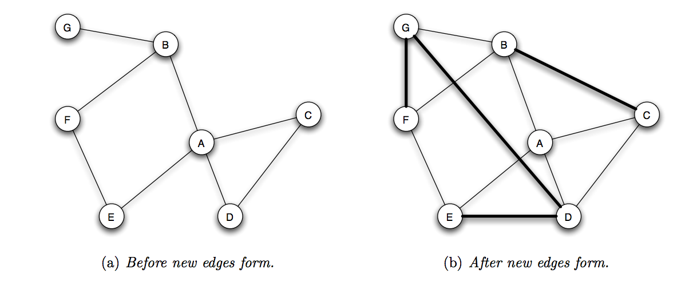
Triads
If two people in a social network have a friend in common, then there is an increased likelihood that they will become friends themselves at some point in the future

Slide 23
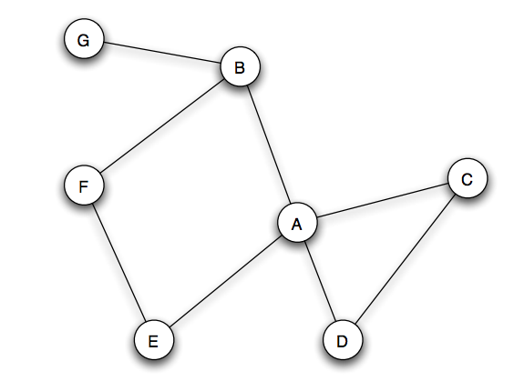
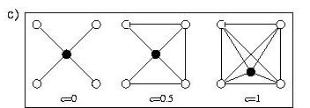
Clustering Coefficient
Clustering coefficient: probability that two randomly selected friends of A are friends with each other
What % of your neighbors are connected to each other?

Slide 24
Graph Models
Random Graph: A random graph is a graph of N labeled nodes where each pair of nodes is connected by a preset probability p.
p=1/6
N=12

Slide 25
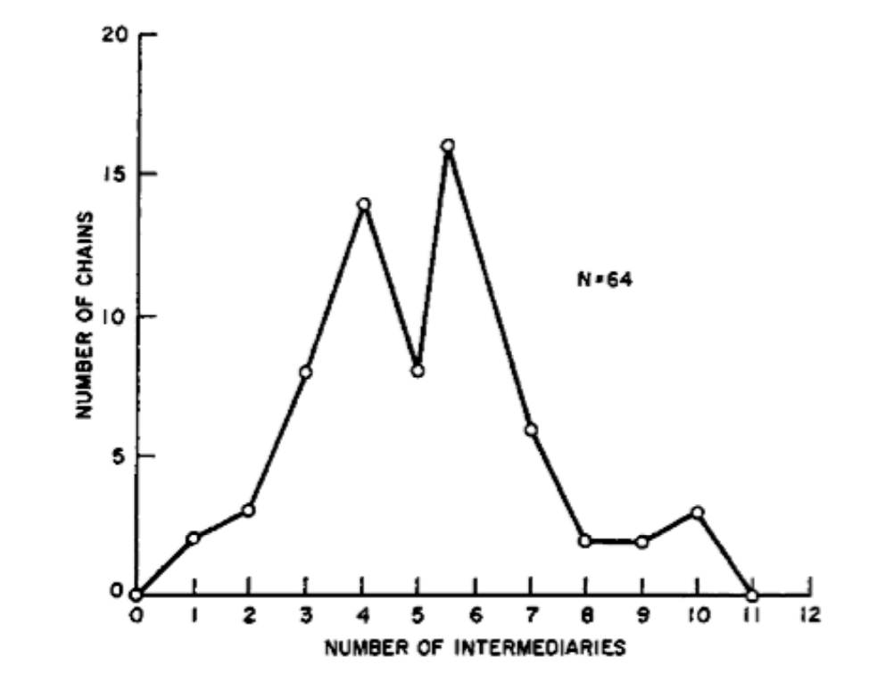
Small World: Six Degrees
Early 20th century Hungarian poet and writer Frigyes Karinthy ﬁrst came up with the idea that we live in “small world”. He suggested, in a play, that any two people among the one and a half billion inhabitants of the earth then were linked through at most ﬁve acquaintances.
The sociologist Stanley Milgram made this famous in his study “The Small World Problem” (1967)—though this study is now largely discredited.
He asked certain residents of Wichita and Omaha to contact and send a folder to a target person (in MA) by sending it to an acquaintance, who would then do likewise etc., until the target person was reached. This would allow Milgram to measure how many “intermediate nodes” would be necessary to link the original sender and the target.
42 of the 160 letters supposedly made it to their target, with a median number of intermediates equal to 5.5.

Slide 26
Milgram Experiment
HOW TO TAKE PART IN THIS STUDY
1. ADD YOUR NAME TO THE ROSTER AT THE BOTTOM OF THIS SHEET, so that the next person who receives this letter will know who it came from.
2. DETACH ONE POSTCARD. FILL IT AND RETURN IT TO HARVARD UNIVERSITY. No stamp is needed. The postcard is very important. It allows us to keep track of the progress of the folder as it moves toward the target person.
3. IF YOU KNOW THE TARGET PERSON ON A PERSONAL BASIS, MAIL THIS FOLDER DIRECTLY TO HIM (HER). Do this only if you have previously met the target person and know each other on a first name basis.
4. IF YOU DO NOT KNOW THE TARGET PERSON ON A PERSONAL BASIS, DO NOT TRY TO CONTACT HIM DIRECTLY. INSTEAD, MAIL THIS FOLDER (POST CARDS AND ALL) TO A PERSONAL ACQUAINTANCE WHO IS MORE LIKELY THAN YOU TO KNOW THE TARGET PERSON. You may send the folder to a friend, relative or acquaintance, but it must be someone you know on a first name basis.

Slide 27
Small-world effect (2)
Distribution of shortest path lengths
Microsoft Messenger network
180 million people
1.3 billion edges
Edge if two people exchanged at least one message in one month period
Pick a random node, count how many nodes are at distance 1,2,3... hops
Number of nodes
7
Distance (Hops)

Slide 28
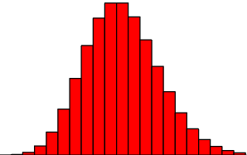
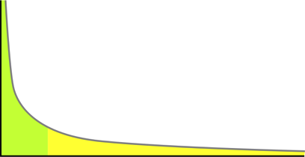
Degree distributions (1)
Let p_{k} denote a fraction of nodes with degree k
We can plot a histogram of p_{k} vs. k
In a Erdos-Renyi random graph degree distribution follows Poisson distribution
Degrees in real networks are heavily skewed to the right
Distribution has a long tail of values that are far above the mean
Heavy (long) tail:
Amazon sales
word length distribution, …

Slide 29
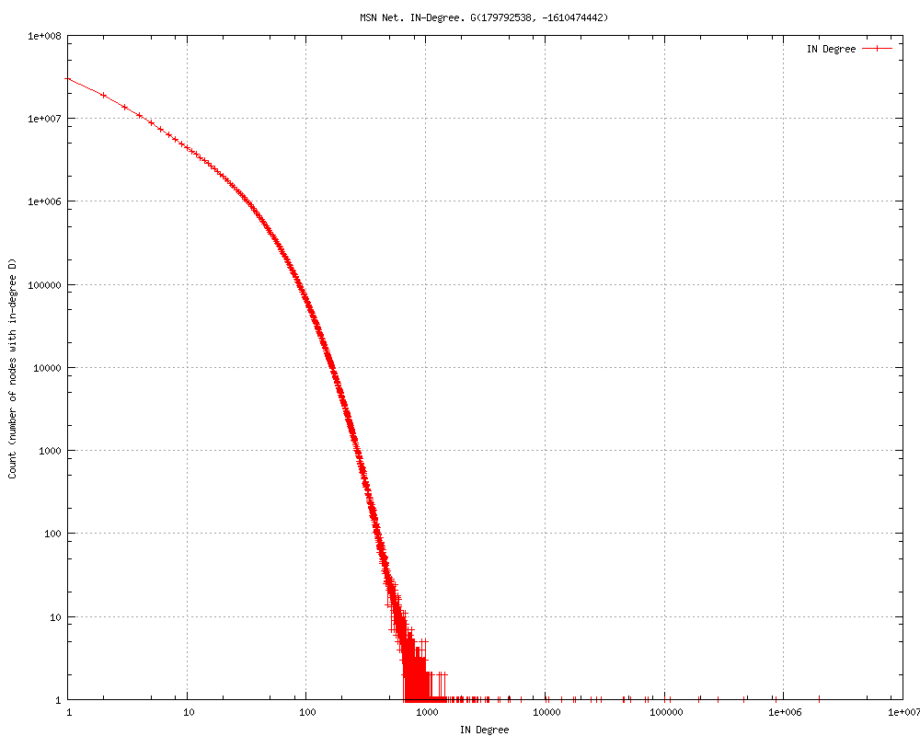
Degree distribution
number of people a person talks to on a Microsoft Messenger
Count
Highest degree
X
Node degree

Slide 30
Network resilience (1)
We observe how the connectivity (length of the paths) of the network changes as the vertices get removed
Vertices can be removed:
Uniformly at random
In order of decreasing degree
It is important for epidemiology
Removal of vertices corresponds to vaccination

Slide 31
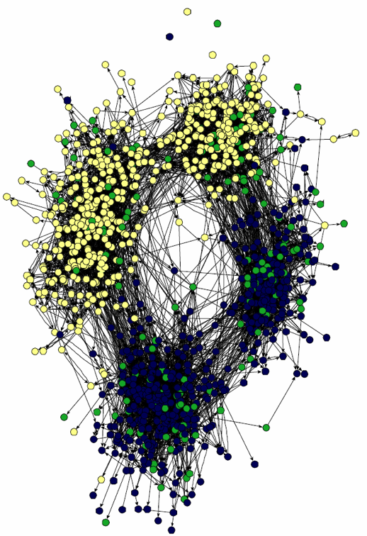
Community structure
Most social networks show community structure
groups have higher density of edges within than accross groups
People naturally divide into groups based on interests, age, occupation, …
How to find communities:
Spectral clustering (embedding into a low-dim space)
Hierarchical clustering based on connection strength
Combinatorial algorithms
Block models
Diffusion methods
Friendship network of children in a school

Slide 32
Examples of Social Network Analysis
436-node network of email exchange at a corporate research lab [Adamic-Adar, SocNets ‘03]
43,553-node network of email exchange at a university [Kossinets-Watts, Science ‘06]
4.4-million-node network of declared friendships on a blogging community [Liben-Nowell et al., PNAS ‘05]
240-million-node network of communication on Microsoft Messenger [Leskovec-Horvitz, WWW ’08]
800-million-node Facebook network [Backstrom et al. ‘11]

Slide 33
Network Analysis Tools
SNAP
JUNG
NetworkX
Pajek
NodeXL
igraph
Visualization
Gephi
GraphViz
Tulip

Slide 34
Optional Assignment
Exercise from http://snap.stanford.edu/proj/snap-icwsm/

Slide 35
Useful Online Sources
Tina Eliassi-Rad: Information in Networks Spring 2013 course at Rutgers
Barabasi: Network Science Book Project
Jure Leskovec: Social and Information Network Analysis Fall 2013 course at Stanford
Book: http://www.cs.cornell.edu/home/kleinber/networks-book/
(lots of slides in this presentation borrowed from these sources)

